Slide 1
Yahweh-Nissi
Exodus 17:8-16

Slide 2
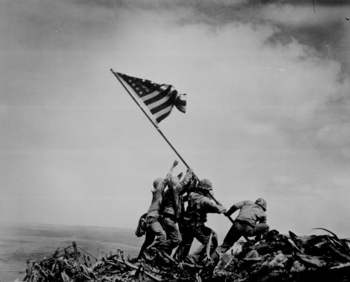

Slide 3
Outline
The Battle
Philip Graham Ryken

Slide 4
Outline
The Battle
The Power of Prayer
Philip Graham Ryken

Slide 5
Outline
The Battle
The Power of Prayer
The Banner of the Cross
Philip Graham Ryken

Slide 6
1. The Battle - A Cowardly Attack

Slide 7
1. The Battle - A Cowardly Attack
“Remember what the Amalekites did to you on the way as you came out of Egypt, how they attacked you on the way when you were faint and weary, and cut off your tail, those who were lagging behind you, and they did not fear God.”
Deuteronomy 25:17-18

Slide 8
A past, present, and future danger to God’s people

Slide 9
A past, present, and future danger to God’s people
Past: Amalek was the grandson of Esau

Slide 10
A past, present, and future danger to God’s people
Past: Amalek was the grandson of Esau
Present: Cowardly attack on the weary

Slide 11
A past, present, and future danger to God’s people
Past: Amalek was the grandson of Esau
Present: Cowardly attack on the weary
Future: Agag - “Your sword has made women childless” (1 Sam 15:33)

Slide 12
A past, present, and future danger to God’s people
Past: Amalek was the grandson of Esau
Present: Cowardly attack on the weary
Future: Agag - “Your sword has made women childless” (1 Sam 15:33)
Haman attempted to completely annihilate the Jews—“young and old, women and little children in one day.”

Slide 13
Moses Commissions Joshua
So Moses said to Joshua, “Choose for us men, and go out and fight with Amalek. Tomorrow I will stand on the top of the hill with the staff of God in my hand.” So Joshua did as Moses told him, and fought with Amalek.
(Exodus 17:9-10)

Slide 14
The children of Israel were not under the power of Amalek—they were free men; and so we are not under the power of sin any longer. The yoke of sin has been broken by God’s grace off our necks, and now we have to fight not as slaves against a master, but as freemen against a foe. Moses never said to the children of Israel while they were in Egypt, “Go, fight with

Slide 15
Pharaoh.” Not at all; it is God’s work to bring us out of Egypt and make us his people, but when we are delivered from bondage, we must be active in our cause. Now that we are alive from the dead we must wrestle with principalities and powers and spiritual wickedness if we are to overcome.
(Charles Spurgeon)

Slide 17
2. The Power of Prayer

Slide 18
2. The Power of Prayer
“So Joshua fought with Amalek while Moses, Aaron, and Hur went up to the top of the hill. Whenever Moses held up his hand, Israel prevailed, and whenever he lowered his hand, Amalek prevailed. But Moses' hands grew weary, so they took a stone

Slide 19
2. The Power of Prayer
and put it under him, and he sat on it, while Aaron and Hur held up his hands, one on one side, and the other on the other side. So his hands were steady until the going down of the sun. And Joshua overwhelmed Amalek and his people with the sword.”
(Exodus 17:10-13)

Slide 20
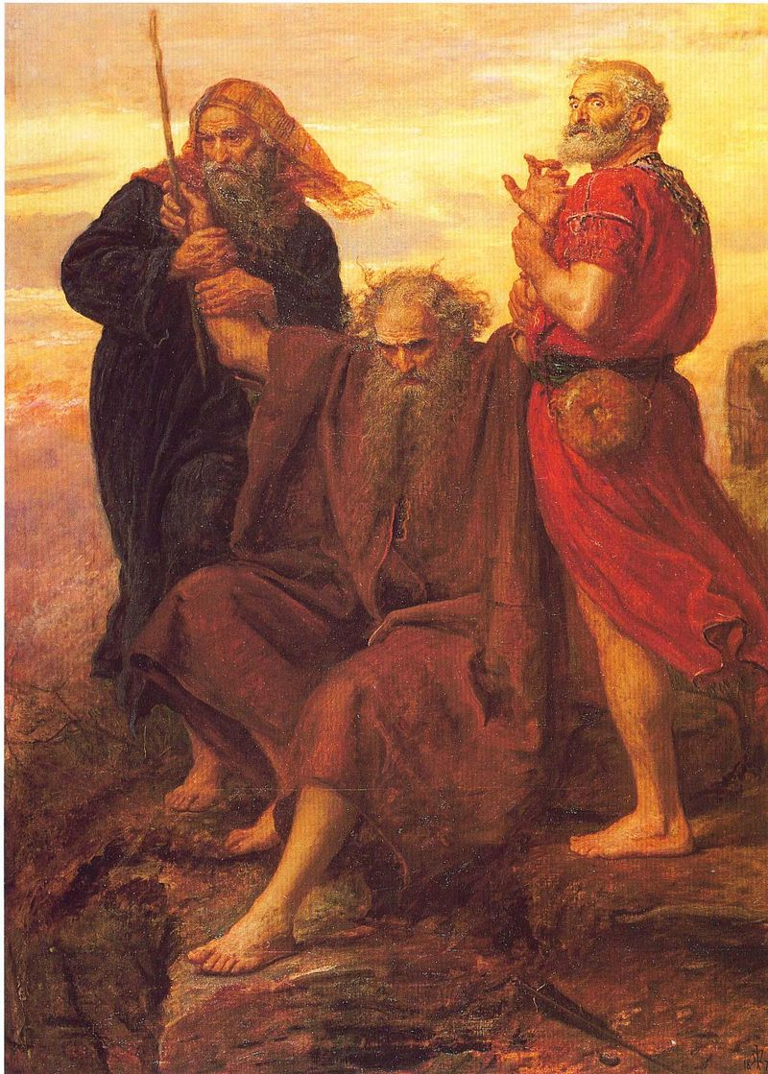

Slide 21
Devoted to Corporate Prayer

Slide 22
Devoted to Corporate Prayer
On their release, Peter and John went back to their own people and reported all that happened. When they heard this, they raised their voices together in prayer to God.

Slide 23
Devoted to Corporate Prayer
On their release, Peter and John went back to their own people and reported all that happened. When they heard this, they raised their voices together in prayer to God.
“Sovereign Lord…consider their threats and enable your servants to speak your word with great boldness. Stretch out your hand to heal and perform miraculous signs and wonders through the name of your holy servant Jesus.”

Slide 24
Devoted to Corporate Prayer
On their release, Peter and John went back to their own people and reported all that happened. When they heard this, they raised their voices together in prayer to God.
“Sovereign Lord…consider their threats and enable your servants to speak your word with great boldness. Stretch out your hand to heal and perform miraculous signs and wonders through the name of your holy servant Jesus.”
After they prayed, the place where they were meeting was shaken. And they were all filled with the Holy Spirit and spoke the word of God boldly.
(Acts 4:23-31)

Slide 25
Peter Released from Prison
“After being rescued from Herod’s clutches, he went to the house of Mary the mother of John, where many people had gathered and were praying.”
(Acts 12:12)

Slide 26
True prayer is born out of felt need
“The best style of prayer is that which cannot be called anything else but a cry.”
(Spurgeon)

Slide 27
True prayer is born out of felt need
“Powerless creatures confessing their powerlessness by turning to the Lord and Giver of all life and all good.”
(Peter Leithart)

Slide 29
3. The Banner of the Cross

Slide 30
3. The Banner of the Cross
“Write this on a scroll as something to be remembered and recite it in the ears of Joshua, that I will utterly blot out the memory of Amalek from under heaven.” And Moses built an altar and called the name of it, The LORD Is My Banner.
(Exodus 17:14-15)

Slide 31
Isaiah Prophesied
“In that day the Root of Jesse will stand as a banner for the peoples; the nations will rally to him, and his place of rest will be glorious”
(Isaiah 11:10)

Slide 32
Jesus is our Banner
Jesus said, “the Son of Man must be lifted up, that everyone who believes in him may have eternal life”
(John 3:15)

